Slide 1
[AI2 MAX Soundbar STB]
Thermal Simulation Condition
Organization
R&D Lab. 2
Issued Date
2021.04.21
Version
0.1

Slide 2
Revision History
Version | Date | Description | Owner
0.1 | 2021/04/21 | 1st Draft version | Lonnie Kim

Slide 3
Thermal Simulation Condition

Slide 4
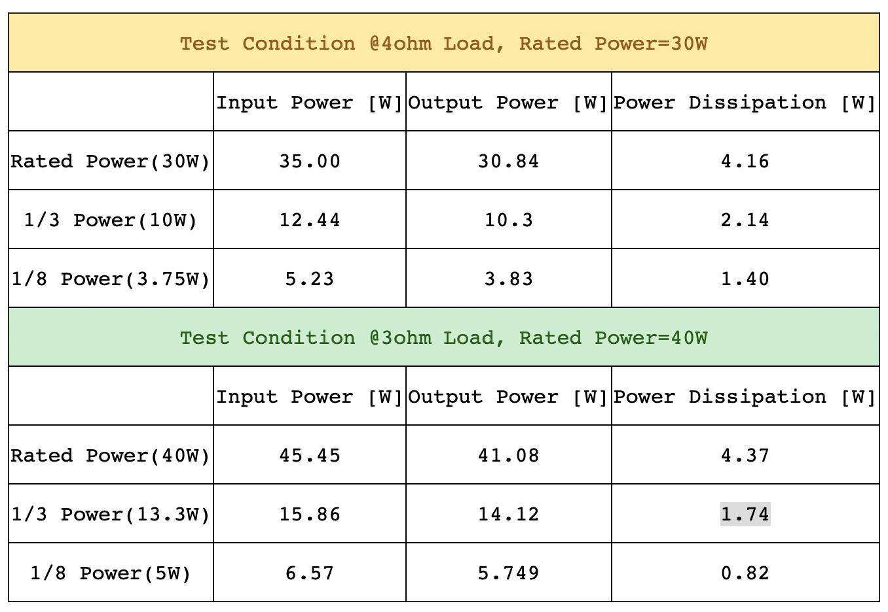
Test Condition
1. Play 4kp60 video from local eMMC with 50% speaker output volume.
2. Iperf 1G via Ethernet.
3. 5 LEDs turn on the brightness(Status & Side LEDs)
4. Amp IC load balance defined 7(full range):3(Woofer) at 1/3 power of Maximum power(140W)
- U201, U301: 0.52W
- U202, U302: 1.50W
5. Test in chamber 25 deg-C for 3 hrs.

Slide 5
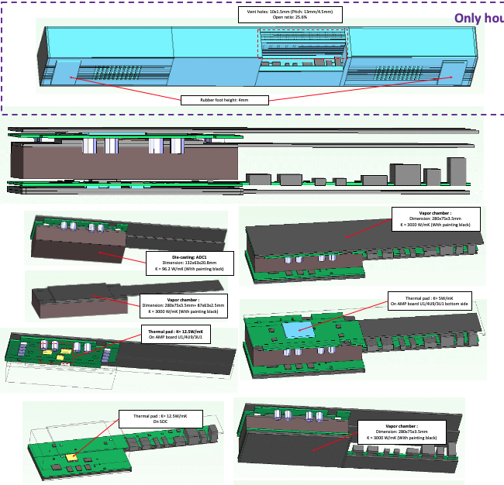
Test Condition thermal spread
Case 1
- No vent at rear
- Vaper chamber

Slide 6
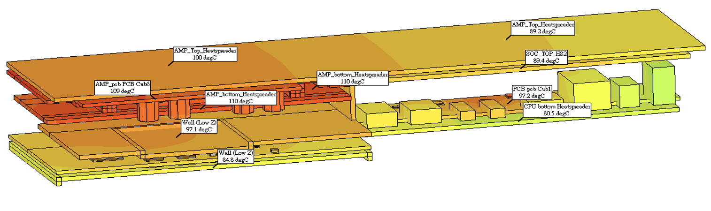
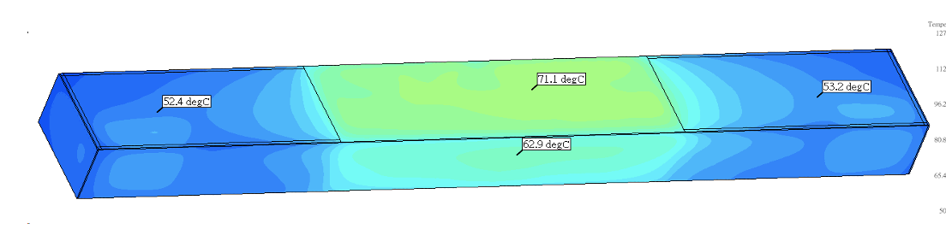
Test Condition thermal spread
Case 2
- No vent at rear
- Heat spreader(Current solution)

Slide 7
Thank you.

